Slide 1

String Algorithms
CISC 610
Data Structures & Algorithms
Caleb Druckemiller, MSC

Slide 2
What are we doing today?
Strings (a review)
String Terminology
Pattern Matching Algorithms
Brute Force
Rabin-Karp
Knuth-Morris-Pratt
Boyer-Moore

Slide 3
Strings (a review)
What is a string?
Characters surrounded by quotes
Immutable sequence objects, with each character representing an element in the sequence

Slide 4
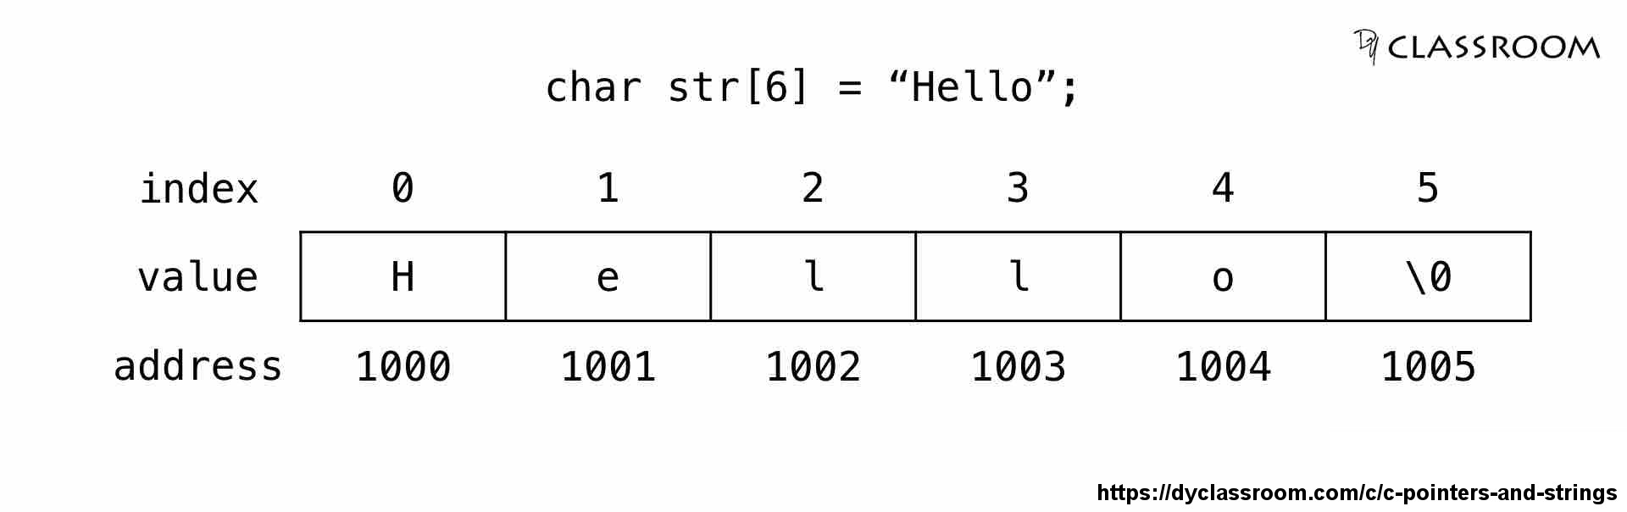
Strings (a review)
Okay, but what is a string really? Like, behind the scenes?
A character array. In C this looks like:
Remember: Under the hood, Python is implemented in C
Languages may store or terminate them differently but, at their core, this is true in all languages

Slide 5
String Terminology
Some common terms we’re going to need:
Substring
Any contiguous sub-portion of a string
Subsequence
A sequence from a string created by removing some of the characters but keeping the order of the characters
Prefix
A substring of any length that starts a string
Suffix
A substring of any length that ends a string

Slide 6
Let’s Talk Pattern Matching!
What is it?
Attempting to find the location of a pattern of characters within a string
Pattern is a sequence of characters being searched for
This basically breaks down to the question:
What is the index of the beginning of a substring of our searched string that equals our pattern?

Slide 7
Let’s Talk Pattern Matching!
How common is this?
VERY!
“Find the first instance of a space in the string”
“Find all addresses with ‘Street’ and change it to ‘St.’”
“Which courses has this student taken that’s a 300 level?”
All languages have some sort of built in functionality
Python: str_var.find(pattern)
Java: str_var.indexOf(pattern)
Excel: =SEARCH(pattern, str_var)
Okay, so what’s the big deal then? Seems easy…

Slide 8
Brute Force Approach!
What is it?
General approach to implementing an algorithm
Slam your head into a brick wall until your head or the wall breaks
Start at a point and process every possible combination

Slide 9
Brute Force Pattern Matching
How?
Start at one end and go to the other
What’s the complication? What are strings again?

Slide 10
Strings (a review)
Okay, but what is a string really? Like, behind the scenes?
A character array. In C this looks like:
Remember: Under the hood, Python is implemented in C
Languages may store or terminate them differently but, at their core, this is true in all languages

Slide 11
Brute Force Pattern Matching
How?
Start at one end and go to the other
What’s the complication? What are strings again?
We can’t just compare an entire string to a section of another
We have to go character by character
What happens if the last character doesn’t match?
“Debases” versus “Debased”
Start all over!
Obviously, this worse if the pattern is long
Okay, okay, let’s get formal…

Slide 12
Brute Force Pattern Matching
Algorithm:
Start a string index counter at 0
For each index in the searched string
Set a pattern index counter at 0, a temp string index counter to the current string index, and a “match” bit to true
While match is still true and neither counter is out of bounds
match = string[temp_str_index] == pattern[pattern_index]
Increment both the temp string and pattern indicies
If you get to the end of the pattern and match is true, return the string index counter
Increment the string index counter
Return that the pattern is not in the string

Slide 13

Brute Force Pattern Matching
Analysis
Let $m$ be the length of the pattern and $n$ be the length of the searched string
Best case scenario?
The pattern is the prefix of the string
The pattern MUST be shorter than the string
That’s a simple test that we can test for
Each character in the pattern is examined once
$O(m)$

Slide 14

Brute Force Pattern Matching
Analysis
Let $m$ be the length of the pattern and $n$ be the length of the searched string
Worst case scenario?
All the characters in the string are AND the pattern are the same EXCEPT for the last
Each letter in the pattern MUST be examined
For every character in the string
$O(m×(n−m+1))$

Slide 15

Brute Force Pattern Matching
Analysis
Let $m$ be the length of the pattern and $n$ be the length of the searched string
Worst case scenario?
$O(m×(n−m+1))$? Isn’t it just $O(m×n)$?
When $m$is relatively small, yes
What happens when $m$ approaches $n$?
Hey…what happens when $m=\frac{n}{2}$?
$O\left(\frac{n}{2}×\left(n−\frac{n}{2}+1\right)\right)$

Slide 16

Brute Force Pattern Matching
Analysis
Let $m$ be the length of the pattern and $n$ be the length of the searched string
Worst case scenario?
$O(m×(n−m+1))$? Isn’t it just $O(m×n)$?
When $m$is relatively small, yes
What happens when $m$ approaches $n$?
Hey…what happens when $m=\frac{n}{2}$?
$O\left(\frac{n}{2}×\left(n−\frac{n}{2}+1\right)\right)=O\left(\frac{n}{2}×\left(\frac{n}{2}+1\right)\right)$

Slide 17

Brute Force Pattern Matching
Analysis
Let $m$ be the length of the pattern and $n$ be the length of the searched string
Worst case scenario?
$O(m×(n−m+1))$? Isn’t it just $O(m×n)$?
When $m$is relatively small, yes
What happens when $m$ approaches $n$?
Hey…what happens when $m=\frac{n}{2}$?
$O\left(\frac{n}{2}×\left(n−\frac{n}{2}+1\right)\right)=O\left(\frac{n}{2}×\left(\frac{n}{2}+1\right)\right)=O\left(\frac{n^{2}}{4}+\frac{n}{2}\right)$

Slide 18

Brute Force Pattern Matching
Analysis
Let $m$ be the length of the pattern and $n$ be the length of the searched string
Worst case scenario?
$O(m×(n−m+1))$? Isn’t it just $O(m×n)$?
When $m$is relatively small, yes
What happens when $m$ approaches $n$?
Hey…what happens when $m=\frac{n}{2}$?
$O\left(\frac{n}{2}×\left(n−\frac{n}{2}+1\right)\right)=O\left(\frac{n}{2}×\left(\frac{n}{2}+1\right)\right)=O\left(\frac{n^{2}}{4}+\frac{n}{2}\right)=O(n^{2})$

Slide 19

Rabin-Karp Algorithm
Do you think we can do better than $O(n^{2})$/ $O(m×(n−m+1))$?
I mean…yeah, I don’t like making these slideshows just for fun
What’s the upside to the brute force algorithm?
Easy to understand
As humans, easy is to tell if “abcd” is in the string “zyxwvutsr”?
What about “abaaaa” in “abaabaabbaababababaaabaaaba?”
What if we could use our brute force algorithm as a basis but ONLY do the comparison if we think we have a chance to match?

Slide 20
A Brief Aside on Hashing
What is hashing?
At it’s most basic, mapping a complex set of data of an arbitrary size to a simpler set of data of a fixed size
Should be fast and minimize duplication (collisions)
VERY poor example: For numerics, recursively add the digits together until you get a single digit
573 = 5+7+3 = 15 = 1+5 = 6
Hashes are easy to compute into, but hard deconstruct back
Hash of 6 could be from 6, 15, 33, 573, or 77777877777
More on this in later weeks

Slide 21
Rabin-Karp Algorithm
What if we use a hash value in our brute force algorithm?
Instead of ALWAYS doing a character-by-character comparison between a substring and the pattern, first we compare hashes
If the hashes don’t match, we don’t do the comparisons
If they do match, we don’t know that they’re the same
Remember 6, 15, 33, 573, or 77777877777
Now we do our character-by-character comparison

Slide 22
Rabin-Karp Algorithm
Complexity
Basically the same as brute force
Functionally faster for several reasons
Hash functions are designed to minimize collisions
The odds of every substring AND the pattern hashing to the same value is functionally 0If the hashes don’t match, we don’t do the comparisons
Hash functions are fast
We are elimination unnecessary comparisons for substrings that CANNOT match

Slide 23
Knuth-Morris-Pratt Algorithm
Abbreviated KMP
Rabin-Karp tried to be efficient when “matching”
However, near-matches will be rare and failures constant
KMP attempts to use those failures efficiently by using any patterns in the pattern
Based on the same brute force algorithm
However, when no match is detected, you do not increment the string position index
Instead it is jumped to the end of the last pattern check but backed off by a value computed by the prefix function

Slide 24
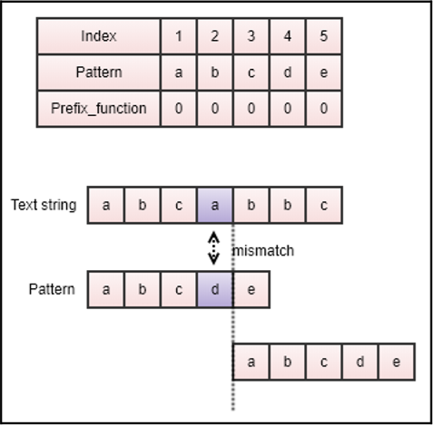
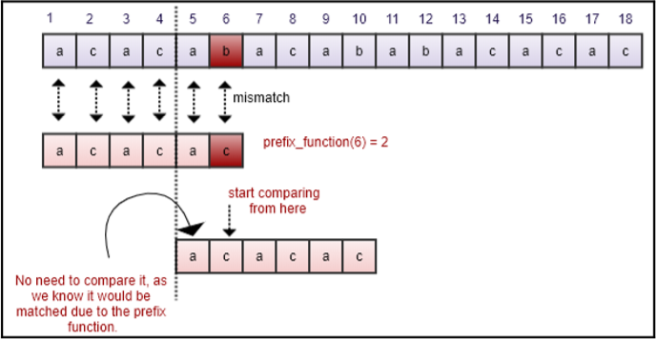
Knuth-Morris-Pratt Algorithm
Two quick examples (we’ll go in more depth in a bit):

Slide 25
Knuth-Morris-Pratt Algorithm
How does the prefix/failure work?
Designed to precompute repetitions within the pattern
Naïve Algorithm:
Create an array of the length of the pattern string For each index in the pattern Get a substring of the pattern from the start up to that index Calculate the maximum length of proper prefix of the substring that is also a suffix of the substring Store that value in the array at that index
Shall we walk through some examples?

Slide 26
Knuth-Morris-Pratt Algorithm
Example 1: Compute the prefix values for “abcabcd”
Index 0: “a” → Default case (not proper) = 0
Index 1: “ab” → No suffix match on prefix = 0
Index 2: “abc” → No suffix match on prefix = 0
Index 3: “abca” → Suffix and prefix of “a” = 1
Index 4: “abcab” → Suffix and prefix of “ab” = 2
Index 5: “abcabc” → Suffix and prefix of “abc” = 3
Index 6: “abcabcd” → No suffix match on prefix = 0
[a, b, c, a, b, c, d]
∴ Prefix array = [0, 0, 0, 1, 2, 3, 0]

Slide 27
Knuth-Morris-Pratt Algorithm
Example 2: Compute the prefix values for “aabaaab”
Index 0: “a” → Default case (not proper) = 0
Index 1: “aa” → Suffix and prefix of “a” = 1
Index 2: “aab” → No suffix match on prefix = 0
Index 3: “aaba” → Suffix and prefix of “a” = 1
Index 4: “aabaa” → Suffix and prefix of “aa” = 2
Index 5: “aabaaa” → Suffix and prefix of “aa” = 2
Index 6: “aabaaab” → No suffix match on prefix = 3
[a, a, b, a, a, a, b]
∴ Prefix array = [0, 1, 0, 1, 2, 2, 3]

Slide 28
Knuth-Morris-Pratt Algorithm
Okay, now what do we do with it?
When we run the comparison, we will set what we consider to be the “start index” of our next substring to be:
Current position – prefix function
We also restart from the prefix function’s position in the pattern
Example: We are searching “aabaabaaab” for pattern “aabaaab”
Our prefix array from the previous slide is [0, 1, 0, 1, 2, 2, 3]
At index 5: S = “aabaab” P = “aabaaa”

Slide 29
Knuth-Morris-Pratt Algorithm
Okay, now what do we do with it?
When we run the comparison, we will set what we consider to be the “start index” of our next substring to be:
Current position – prefix function
We also restart from the prefix function’s position in the pattern
Example: We are searching “aabaabaaab” for pattern “aabaaab”
Our prefix array from the previous slide is [0, 1, 0, 1, 2, 2, 3]
At index 5: S = “aabaab” P = “aabaaa”

Slide 30
Knuth-Morris-Pratt Algorithm
Okay, now what do we do with it?
When we run the comparison, we will set what we consider to be the “start index” of our next substring to be:
Current position – prefix function
We also restart from the prefix function’s position in the pattern
Example: We are searching “aabaabaaab” for pattern “aabaaab”
Our prefix array from the previous slide is [0, 1, 0, 1, 2, 2, 3]
At index 5: S = “aabaab” P = “aabaaa”

Slide 31
Knuth-Morris-Pratt Algorithm
Okay, now what do we do with it?
When we run the comparison, we will set what we consider to be the “start index” of our next substring to be:
Current position – prefix function
We also restart from the prefix function’s position in the pattern
Example: We are searching “aabaabaaab” for pattern “aabaaab”
Our prefix array from the previous slide is [0, 1, 0, 1, 2, 2, 3]
Restart the string at index 5 – 2, pattern at 2 and keep going: S = “aabaab…” P = “aab…”

Slide 32
Boyer-Moore Algorithm
We’ve tried to be efficient on matching and mismatching
Boyer-Moore takes a different approach to “efficiency on mismatching”
Pattern is moved from left to right along the text string
Character-by-character search is done right to left
On a mismatch, two heuristics are used to maximize the distance that we can shift our pattern within the searched text
Bad character heuristic
Good suffix heuristic
By maximizing shifting, we can minimize comparisons

Slide 33
Bad Character Heuristic
When a character doesn’t match, let’s figure out if it ever could match
If the character from the string isn’t in the pattern, we never have to examine that character again
Move the pattern past that character
(Set the string index counter to that index + 1)
If that character exists once in the pattern
Shift the pattern so that the “bad character” from the string is inline with its one instance in the pattern
Restart your comparisons from the right side of the pattern

Slide 34
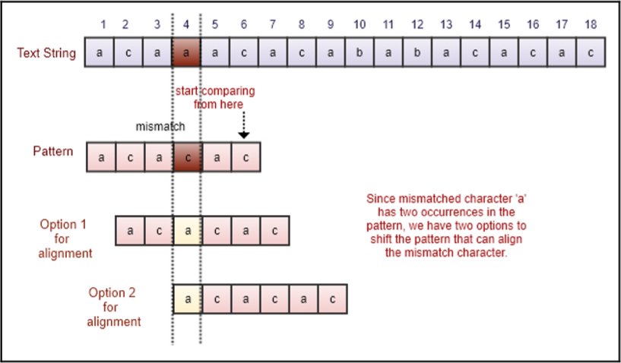
Bad Character Heuristic
When a character doesn’t match, let’s figure out if it ever could match
What if there’s more than one occurrence of the bad character in the pattern?
Which do we choose?
The option with the minimum number of shifts (#1)

Slide 35
Good Suffix Heuristic
When a character doesn’t match, use the information from the already matched suffix
We know the suffix up until this point has matched the string
If there’s another instance of that subpattern in the pattern, line those up
Or if a sub-suffix is the prefix of the pattern, line that up

Slide 36
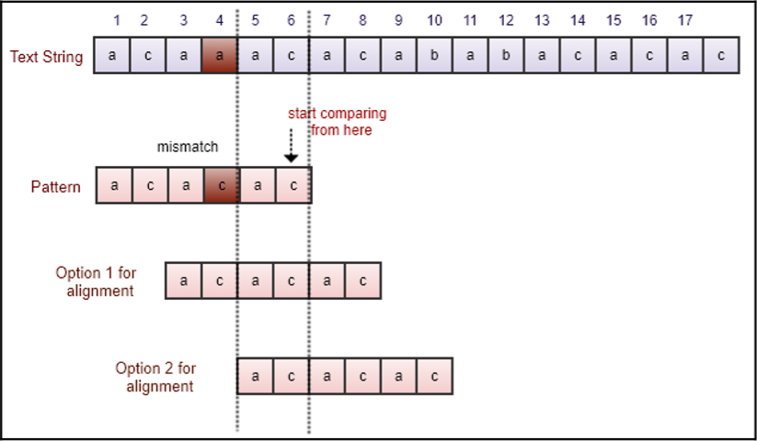
Good Suffix Heuristic
When a character doesn’t match, use the information from the already matched suffix
If there’s another instance of that subpattern in the pattern, line those up
Like the bad character heuristic, do the minimum shifts (#1)

Slide 37
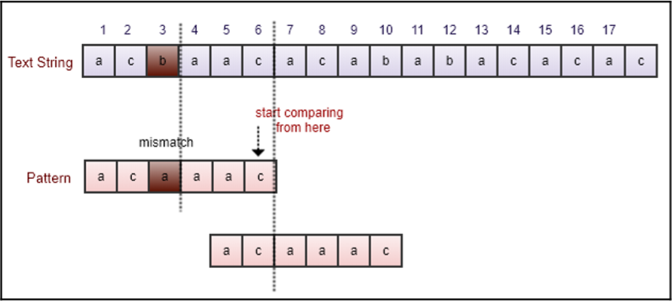
Good Suffix Heuristic
When a character doesn’t match, use the information from the already matched suffix
Or if a sub-suffix is the prefix of the pattern, line that up

Slide 38
Good Suffix Heuristic
When a character doesn’t match, use the information from the already matched suffix
Okay, but what neither situation is true?
What if the suffix only occurs once in the pattern (at that point?)
Shift the pattern past that point
(Set the string index counter to that index + 1)

Slide 39
Boyer-Moore Algorithm
Okay, so we have our bad character and good suffix
Now what? How do we combine them?
Step 1) Calculate both heuristics
Both heuristics calculate the maximum distance you can safely shift the pattern under that methodology
If we shift it the smaller distance, we know that we could have safely shifted it further by the other heuristic
Therefore, if we can safely shift our pattern by the larger shift
Step 2) Shift the pattern/string index counter by the larger amount

Slide 40

Boyer-Moore Algorithm
Performance?
Great! (Especially when searching longer strings of text)
When the pattern appears in the string
$O(m×n)$
When the pattern doesn’t appear in the string
$O(m+n)$
Provable that the worst-case upper bound is $3n$ comparisons

Slide 41
Questions?

